Slide 1


Development with Git
Generic Guidance for using Git and keeping your commits tidy.

Slide 2
Motivation

Slide 3
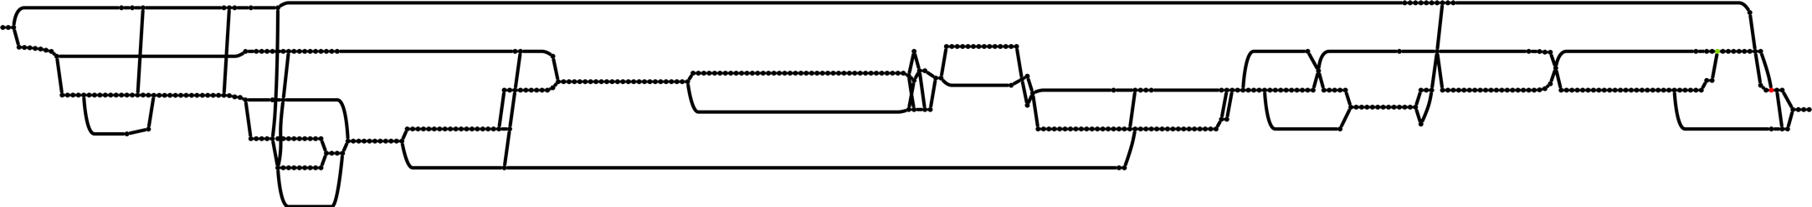
A nonlinear history is hard to debug

Slide 4
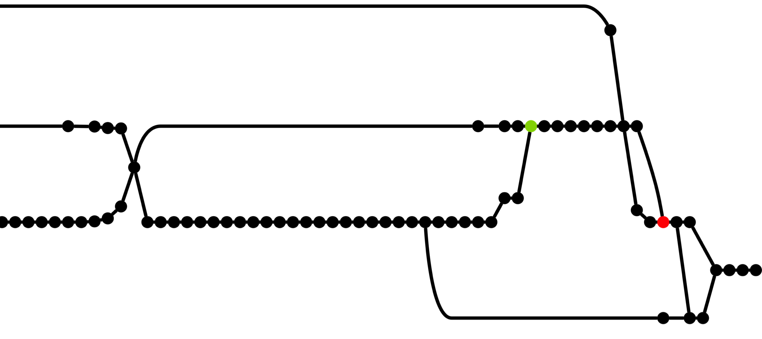
A nonlinear history is hard to debug
What is happening here?
???.
???
????

Slide 5
A nonlinear history is hard to debug
What is happening here?
This is a long running branch dragged into a new piece of work.
If this commit caused a conflict which piece of work caused it?
Why take a branch from here???

Slide 6
A nonlinear history is hard to debug
What is happening here?
This is a long running branch dragged into a new piece of work.
THIS IS A REAL WORLD EXAMPLE!
If this commit caused a conflict which piece of work caused it?
Why take a branch from here???

Slide 7
A Git workflow with linear history

Slide 8
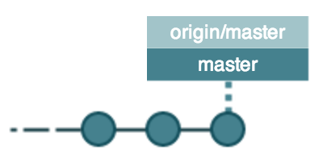
Step 0: Get up-to-date
Don’t start any work with out getting the latest & best code.
The ‘master’ branch may not be the name of the current one for your project.
git checkout master
git pull --rebase

Slide 9
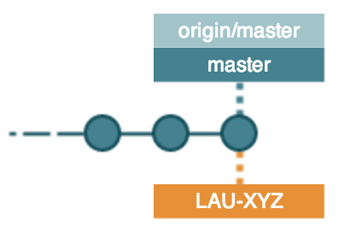
Step 1: Check out feature branch and do work
Don’t start any work with out getting the latest & best code.
The ‘master’ branch may not be the name of the current one for your project.
git checkout -b LAU-XYZ
Create a branch.
The branch name will be named to match the JIRA ticket.

Slide 10
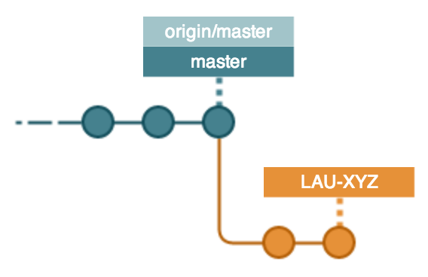
Step 2:Save your work (locally)
Work happens. Add your files and commit as you go.
git add <files to add>
git rm <files to delete>
git commit -m"LAU-XYZ: Enter message"
Various commits as you finish a part of the work.
Add the JIRA ticket number for tracking.

Slide 11
Step 3: Save your work (centrally)
Push all your changes to a branch on the central server.
git push
origin/LAU-XYZ
Saved to main server. - Note this should not cause an automatic build.

Slide 12
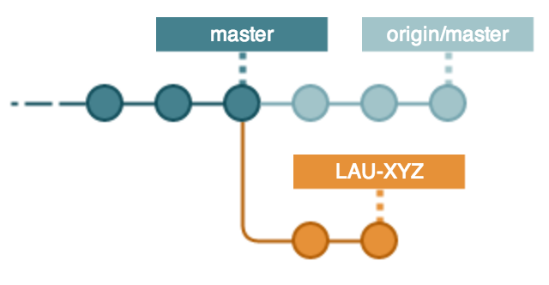

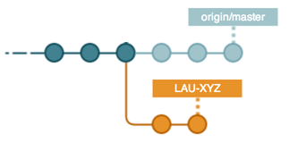
Step 4: Keep Up To Date
Every day there may be changes from other developers you need to include.
git checkout master
git pull --rebase
Not needed in this case but a good habit.

Slide 13
Step 5: Prepare to get Changes
Save your work in case of conflicts.
git checkout LAU-XYZ
git checkout –b TMP
TMP
Pushes your work on to a temporary branch.

Slide 14
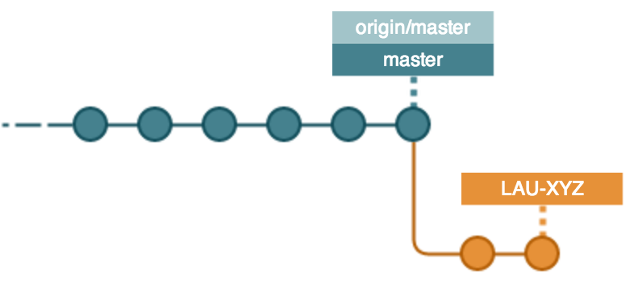

Step 6: Try the changes with your work
Incorporate your work & any changes on the TMP branch. Resolving any issues as you precede.
git rebase master
TMP
Your commits now look as if they happened after the changes on master.

Slide 15
Step 7: Keep Up To Date
Rebuild/Test the changes … avoid the unexpected!
Did the changes break your work.
mvn clean test
TMP

Slide 16
Step 8: Keep Up To Date
Everything is ok so it is now fine to update your working branch to include the new code.
git checkout LAU-XYZ
git rebase tmp
TMP

Slide 17
Step 9: Tidy up!
Now your working branch is ok you can ditch the TMP branch.
git delete TMP

Slide 18
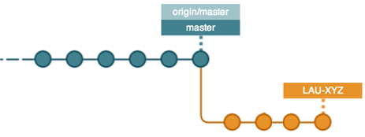
Step 10: Do More Work
Your commits run on to the end of the block of work.
Repeat steps #2 → #10 until you are done.
Origin/LAU-XYZ
More work!

Slide 19
Step 11: Incorporate your work
When your work is done it needs to go back to master. (According to project’s DoD)
Before proceeding ensure that you are up to date!
Your commits need to be in this state.

Slide 20

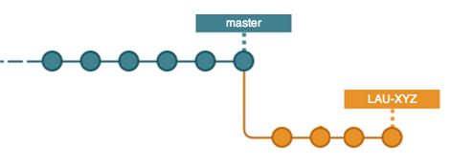

Step 11: Incorporate your work
When your work is done it needs to go back to master.
Before proceeding ensure that you are up to date!
NOT in this state!
WRONG!

Slide 21
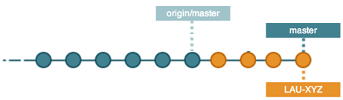
Step 11: Incorporate your work
Merge your feature into master.
git checkout master
git merge LAU-XYZ

Slide 22
Step 12: Build & Re-Test
You need to be sure that your changes have not broken any thing, before you incorporate them into origin/master.
mvn clean test

Slide 23
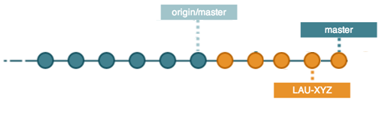
Step 13: Update the version
Your changes are different from the ones at origin/master. So update the version number to show this.
mvn versions:set -DnewVersion=1.0.3-SNAPSHOT
git commit -m"LAU-XYZ Complete, version updated to 1.0.3-SNAPSHOT"
Unless you are the build-manager your version should be a SNAPSHOT.

Slide 24
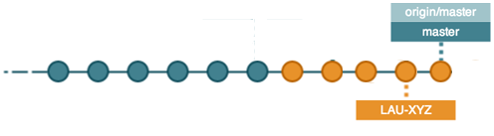
Step 14: Merge your feature into master
Push the changes to the main server.
git pull --rebase
… No changes came down
git push
If changes come down then you have to start again at step #4!

Slide 25
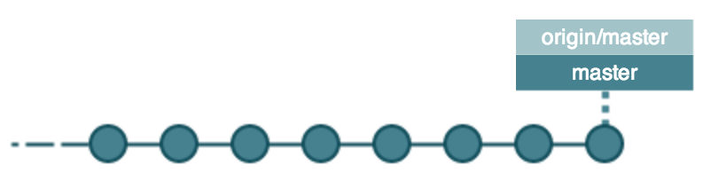
Step 15: Finished… delete your feature branch
Once your branch is accepted then it can be deleted.
It is possible that this action is done by the build manager.
git branch -d LAU-XYZ

Slide 26
Step X : Resolving conflicts
git status
Conflicting files are listed as both modified and will contain markers:
<<<<<<< HEAD
Some content
=======
Some conflicting content
>>>>>>> LAU-XYZ The message of the conflicting commit
Edit these files and, once the conflicts are resolved:
git add <files that had conflicts>
git rebase --continue

Slide 27
Pushing feature branches to the remote repo
(when it’s just one person working on it at once)
git push -u origin LAU-XYZ
Until you rebase, you can push as usual
git push
After rebasing onto master, however, you will have to force push
git push --force
Be very careful with force push… it will overwrite your remote branch even if you are not up-to-date (so if you accidentally force push to master you will make everyone very unhappy)

Slide 28
Sharing feature branches
Force push is not friendly!
Once you have rebased and force pushed, your collaborators cannot pull.
Long-lived shared feature branches are therefore slightly tricky.
The easiest approach is to
get everyone up-to-date,
rebase against master,
force push,
discard local branches and check out a fresh copy of the shared branch.
See the wiki for the full workflow, and how to handle the case where everyone cannot get up-to-date before you rebase.
https://pangaea.atlassian.net/wiki/display/DEV/Sharing+a+feature+branch

Slide 29
Best Practices
Rewriting history
Group commits into logical chunks to make it:
easier for other people to follow what you did, and
easier to resolve conflicts when rebasing onto master.
git rebase -i HEAD~8
pick | use this commit as-is (the default behaviour)
reword | use this commit, but edit the commit message
squash | use this commit, but combine it with the previous one and edit the resulting message
fixup | squash, but discard this commit’s message and use the previous commit’s message
edit | amend this commit – for splitting commits, or removing files you didn’t mean to add
But never ever do this if you have already pushed your commits!

Slide 30
Best Practices
Commit messages
Short but descriptive
if you’re writing “and” a lot, think about splitting up your commits
Prefix with the ticket number
if the commit doesn't relate to a ticket, then no prefix
In the imperative present tense
“Change something”
“Changed something”
“Changes something”
“Changing something”

Slide 31
Development with Git
And that's it!

